Slide 1


Divide and Conquer the Embedding Space for Metric Learning
Team: Strawhat
Ajay Shrihari (20171097)
Aniket Mohanty (20171150)
Sasi Kiran (20171110)

Slide 2
Overview
In an embedding space, we generally try to learn one distance metric and use that to train the given data.
The issue with this is that it results in overfitting since the embedding space can be very large and based on a single distance metric, the model does not generalize well.
‘Divide and Conquer the Embedding Space for Metric Learning’ (CVPR 2019), aims to solve this problem by dividing the metric space into non-overlapping subsets of data and applying separate learning for each by an ensemble method.

Slide 3
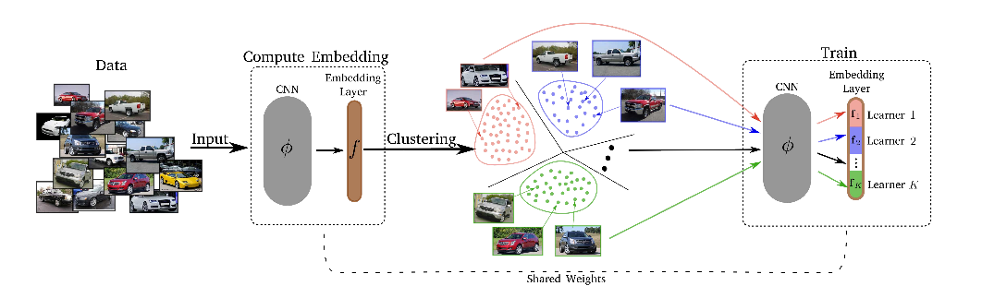
APPROACH:

Slide 4
APPROACH:
The embeddings for the training images are computed and then clustered into K-clusters (disjoint subsets).
The d-dimensional embedding spaces are then split into K subspaces of d/K dimensions each.
Next, for each of the subspaces, a separate loss is assigned and trained. Different weights are learned for different subspaces, and we get K different distance metrics for the disjoint learners.
This process is repeated every T-epoch.

Slide 5
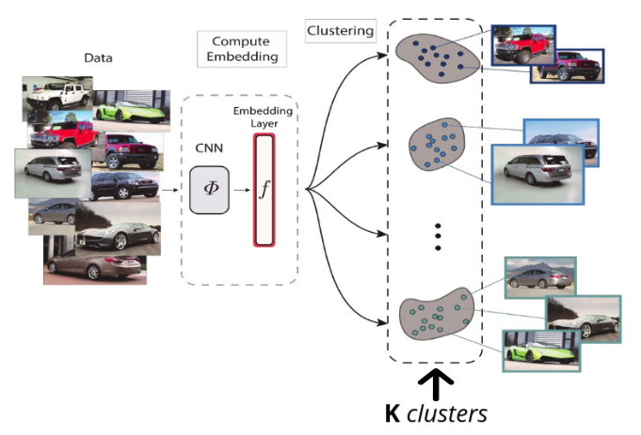
PROGRESS:

Slide 6
PROGRESS:
We have used a pretrained ResNet-50 model along with extra fully connected layers in order to get embeddings.
We have implemented custom modules for random sampling and semi hard negative mining and implemented regular metric learning on the Stanford Online Products Dataset.
In random sampling, we observed a low triplet loss while training, suggesting the following:
In the acquired sample, the negative examples are very close to the margin.
The positive examples are very close to the anchor.
Hard negative mining considers the negative examples very close to the anchor. But experiments have shown that hard negative mining converges to local minima in the first few iterations.

Slide 7
PROGRESS:
We implemented Semi hard negative mining, which does the following:
Considers the negative examples, closer than the furthest positive example in the sample.
Considers the positive examples, far away from the nearest negative example in the sample.
The Triplet loss expression is given below, which tries to pull positive examples closer to the anchor, and negative examples away from the anchor. This has been used as our loss function, based on which we have trained our model.
Triplet Loss = max(0 , [ d₊ - d₋ + 𝛂 ] )
We have implemented a Normalized Mutual Information (NMI) score, which scales results between 0 (no mutual information) and 1 (perfect correlation) to evaluate clustering.

Slide 8
CHALLENGES FACED:
During the testing period, we first started out with the KMeans Clustering in the Sklearn package. We found that this is very slow for an entire pass on the test data used. Hence, we implemented the clustering using the GPU accelerated library ‘FAISS’.

Slide 9
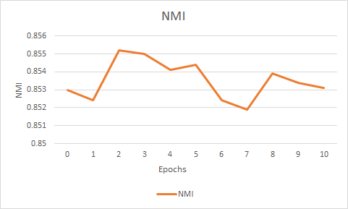
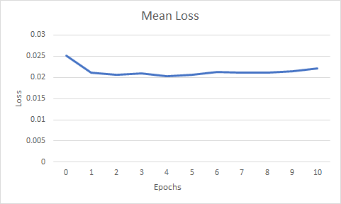
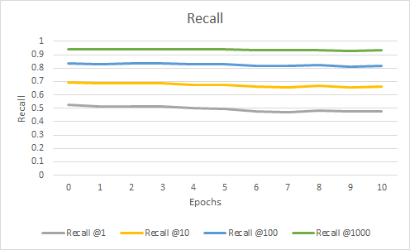
RESULTS:
We trained our model over 10 epochs using random sampling and triplet loss, and plotted the results: mean loss, NMI, and recall@k.

Slide 10
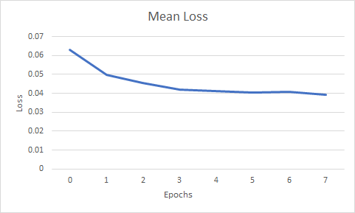
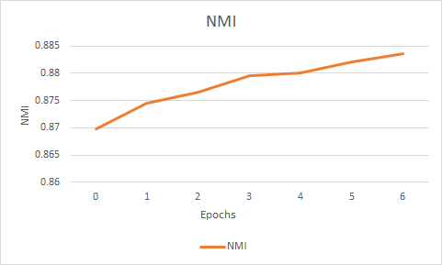
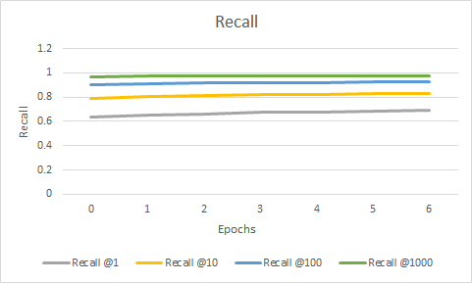
RESULTS:
We trained our model over 10 epochs using random sampling and triplet loss, and plotted the results: mean loss, NMI, and recall@k.

Slide 11
FUTURE WORK:
The next step to be enacted in the project is dividing the embedding space into K learners and train each learner in conjunction with the ResNet50 model separately. After a certain number of iterations, we resample the points and restart the process until the model converges to a good output.

Slide 12
After Mid Evaluation:
After the mid evaluation, divided the embedding space into K learners, and trained each learner in conjunction with the Resnet50 model separately.
After a certain number of iterations, we clustered the points again and restarted the process for M epochs until the model converged to a good output.
To test the model on a variety of different and varying data, we tested the code on the Stanford Online Products dataset, Cars196 dataset, as well as the Cub200 dataset.

Slide 13
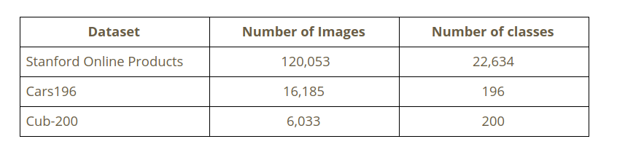
Datasets Used :
We trained our model over these 3 datasets, varying the number of learners to 2 ,4, 8 and 16 and 3 different loss functions.

Slide 14
Other Loss functions:
We employed the use of two other losses apart from triplet loss.
Margin loss
Proxy-NCA loss.
For these loss functions, we trained and tested the Cars196 and Cub200 datasets.

Slide 15
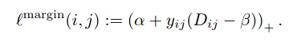
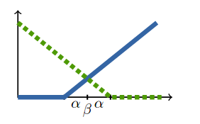
Margin Loss:
The expression for margin loss is :
Here, β is the variable that denotes the boundary between the positive and the negative pairs, α is the variable that decides the margin of separation, and y_{ij}∈ {−1,1}. We can visualize this loss function by the following diagram:

Slide 16
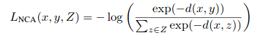
Proxy-NCA Loss:
NCA loss, similar to triplet loss, is a loss function that tries to make a variable x closer to y than to any element in a set Z using exponential weighting. The expression is given as follows:
While training a metric learning model with any loss, each batch samples a very small subset of all the possible triplets. The convergence rate of the model is highly dependent on being able to find triplets which actually motivate training, i.e, those which have a larger loss.

Slide 17
Proxy-NCA Loss:
In this scenario, proxy ranking loss samples a small set of points in the entire set of triplets as positive and negative examples.
These proxies serve as a concise representation for the set of triplets, since the distances between the anchor and the positive, as well as the anchor and the negative are not affected.
This loss is difficult to optimize with gradient based methods, but the proxy approximation can be used to bound the NCA loss described, and proves useful in distance based metric learning approaches

Slide 18
Image Recommendation on the dataset
Apart from this, we wrote code to find the closest images to a given input image based on the embedding space created by the Divide and Conquer approach to metric learning.
The approach taken for this was to use the search index module inbuilt into the FAISS package, which allowed us to use the resources of the present GPU’s and calculate the closest images to the query image using euclidean (L2) distance. This gave us good image recommendation results as will be shown next.

Slide 19
RESULTS

Slide 20
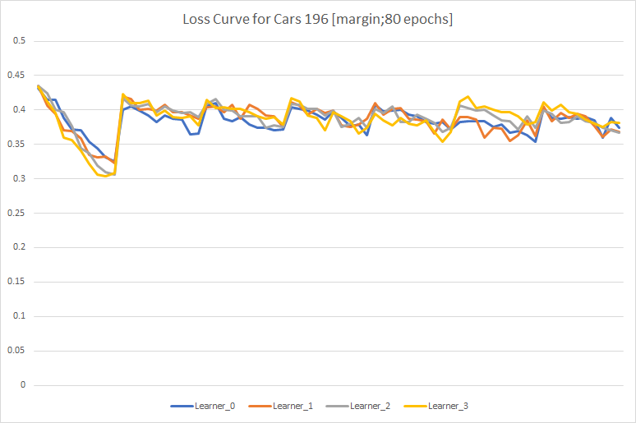
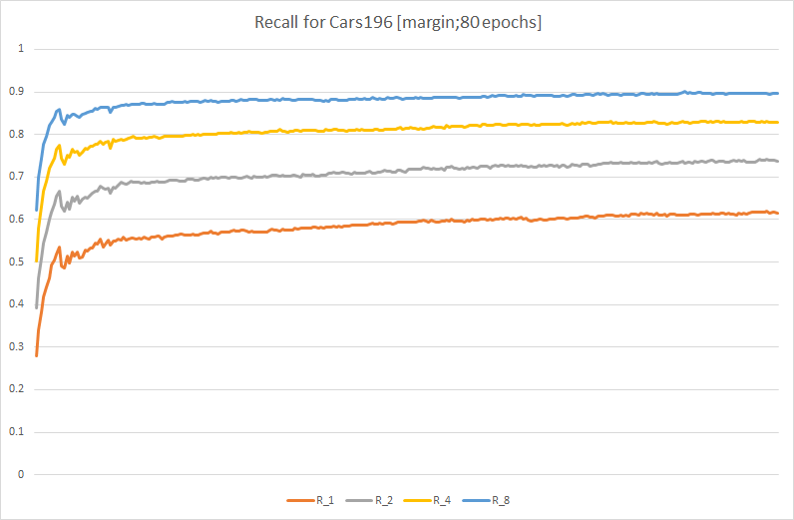
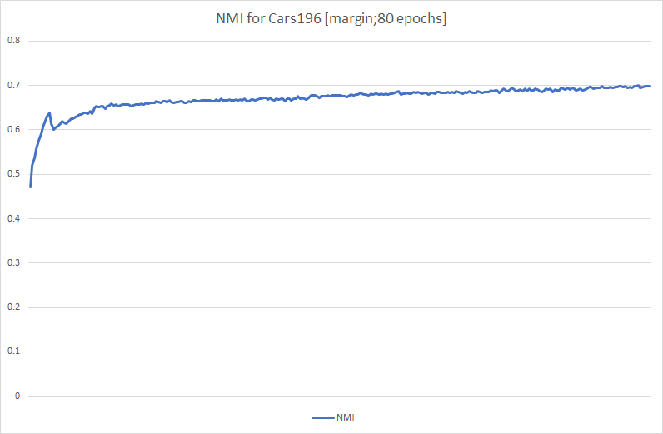
Learner loss –Recall –NMI results:
Dataset: CARS196
Loss function: Margin
Number of Learners: 4
Number of Epochs: 80

Slide 21
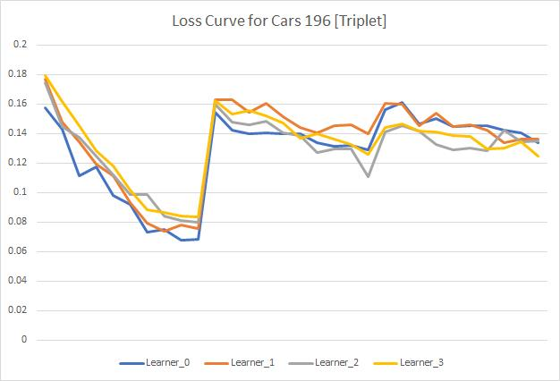
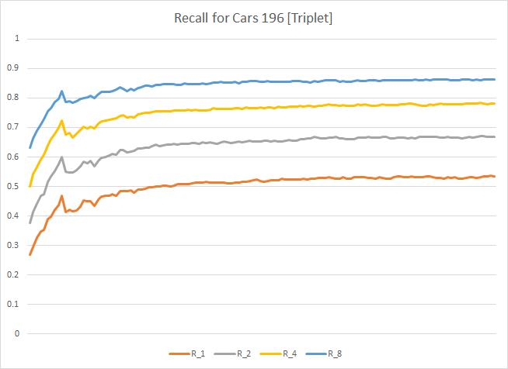
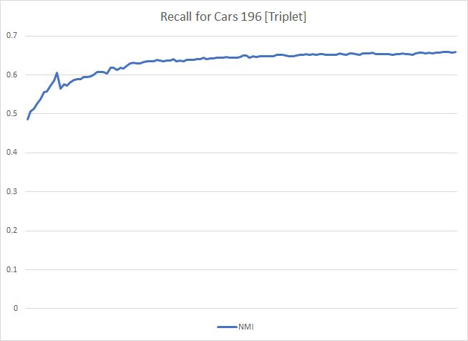
Learner loss –Recall –NMI plots:
Dataset: CARS196
Loss function: Triplet
Number of Learners: 4
Number of Epochs: 80

Slide 22
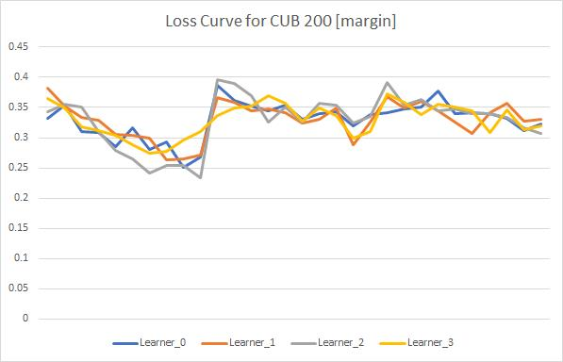
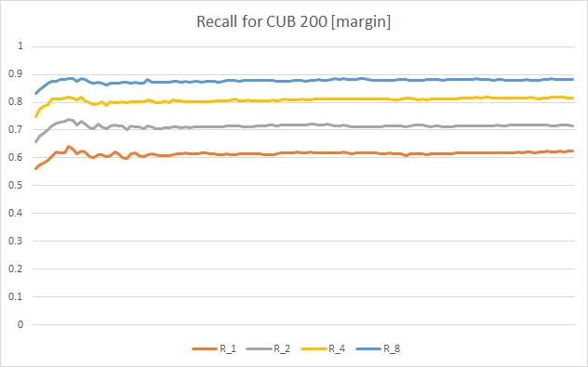
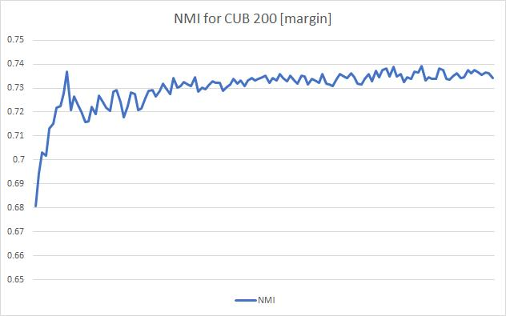
Learner loss –Recall –NMI plots:
Dataset: CUB200
Loss function: Margin
Number of Learners: 4
Number of Epochs: 40

Slide 23
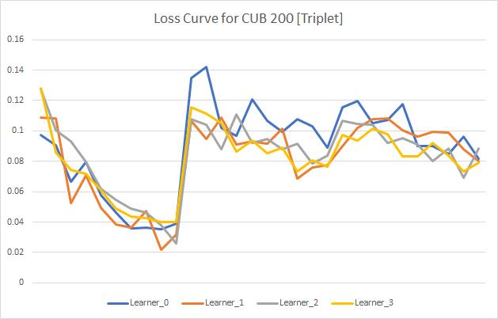
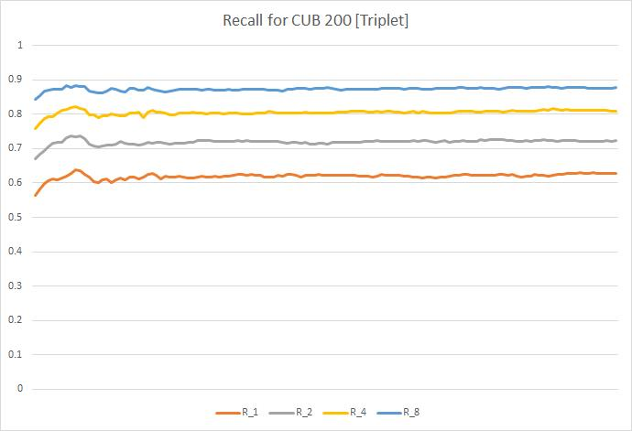
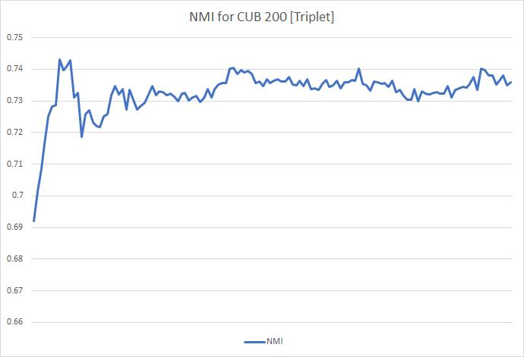
Learner loss –Recall –NMI plots:
Dataset: CUB200
Loss function: Triplet
Number of Learners: 4
Number of Epochs: 40

Slide 24
Learner loss –Recall –NMI plots:
Dataset: CUB200
Loss function: Triplet
Number of Learners: 4
Number of Epochs: 40

Slide 25
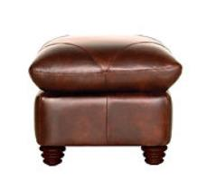
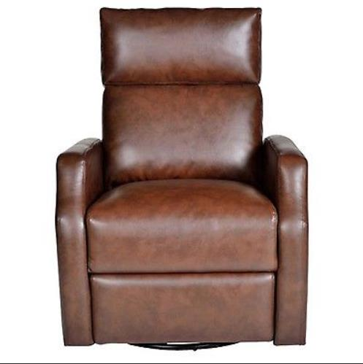
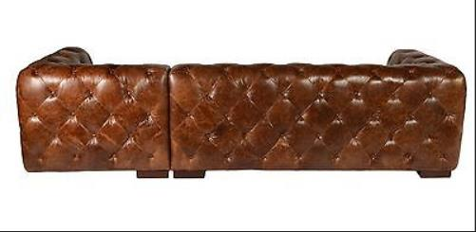
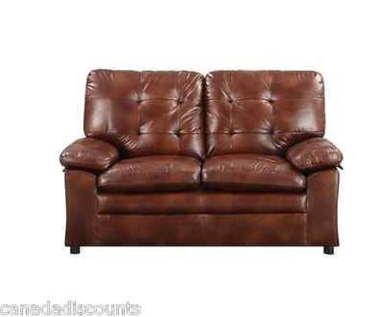
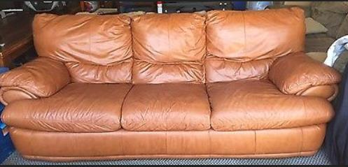
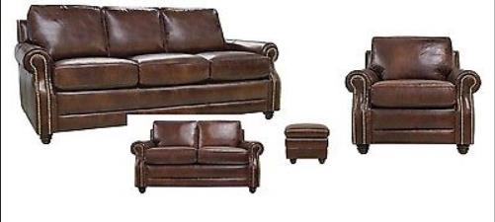
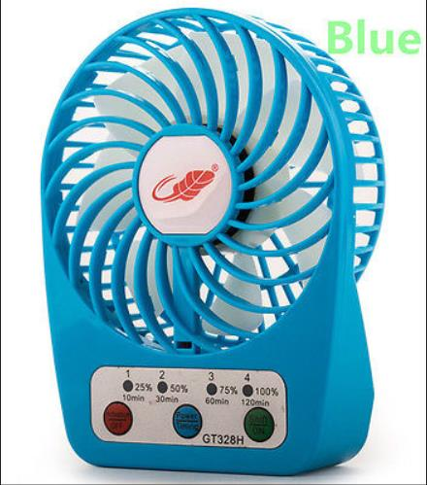
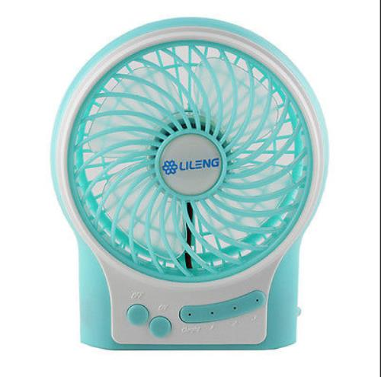
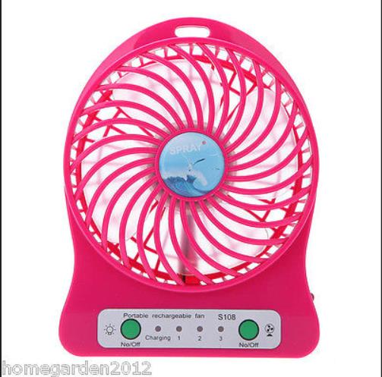
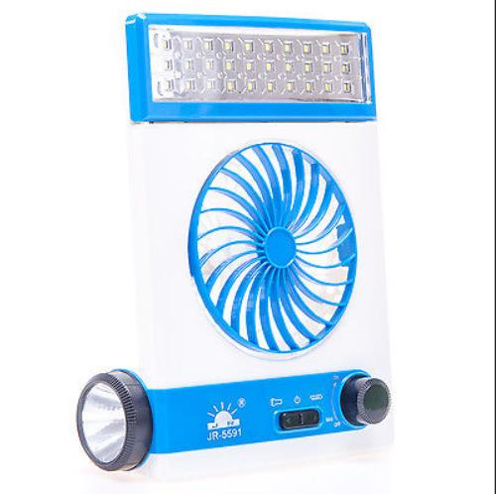
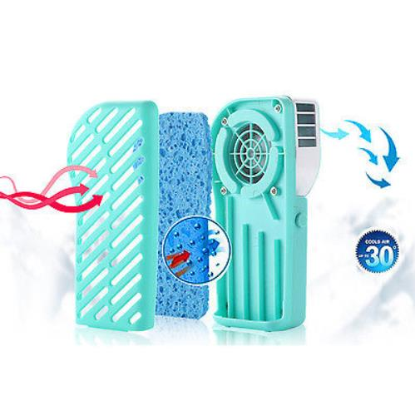
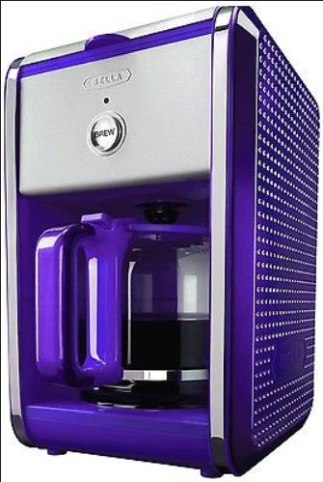
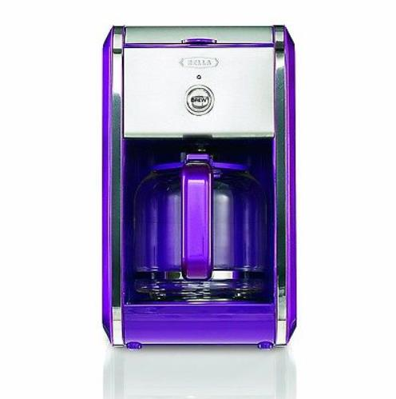
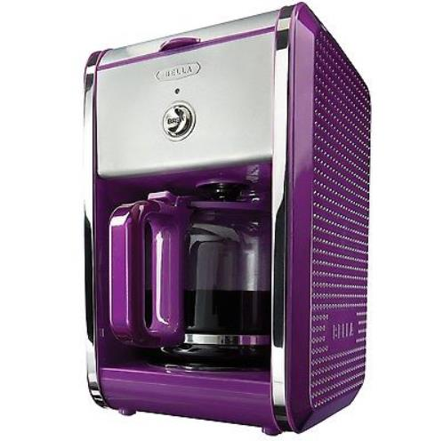
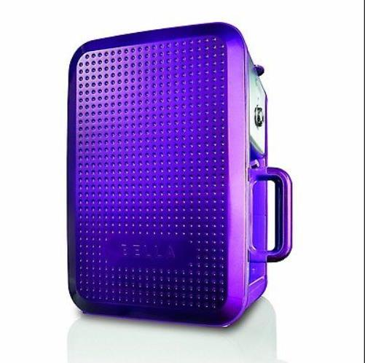
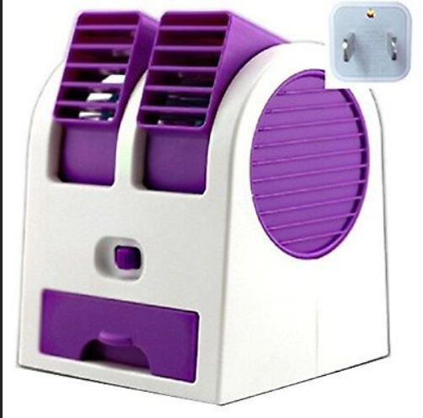
Good Query – Recommendation results on SOP Dataset:
Query -1
Top – 5 Recommentation results
Query -2
Top – 5 Recommentation results

Slide 26
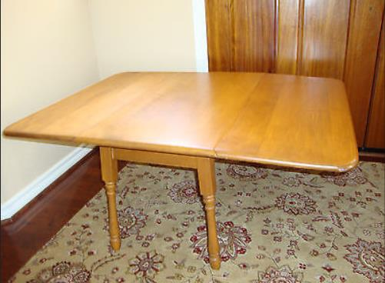
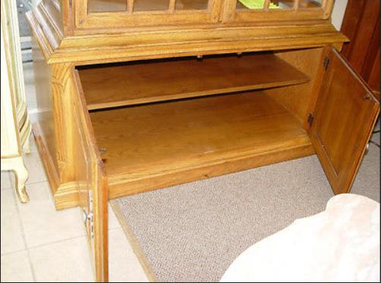
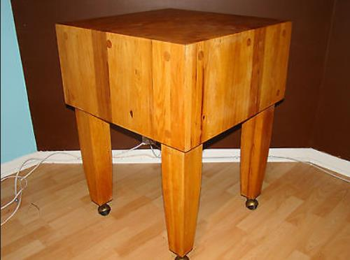
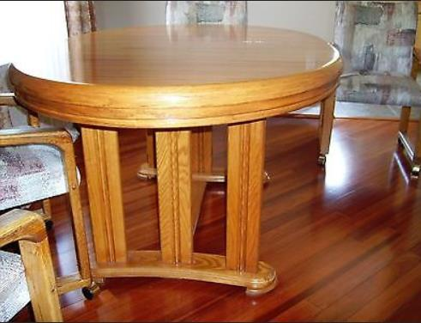
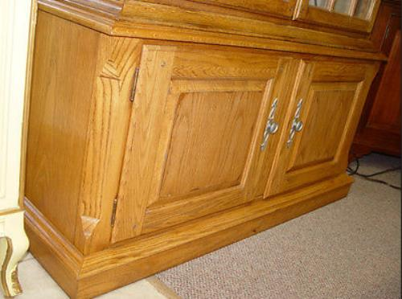
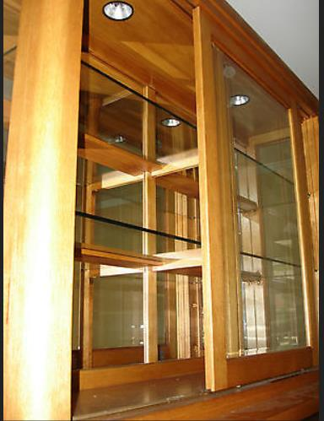
Bad Query – Recommendation results on SOP Dataset:
Query -1
Top – 5 Recommentation results

Slide 27
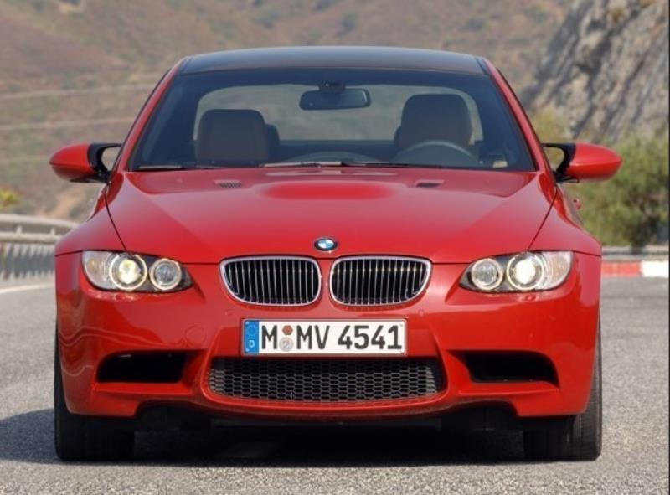
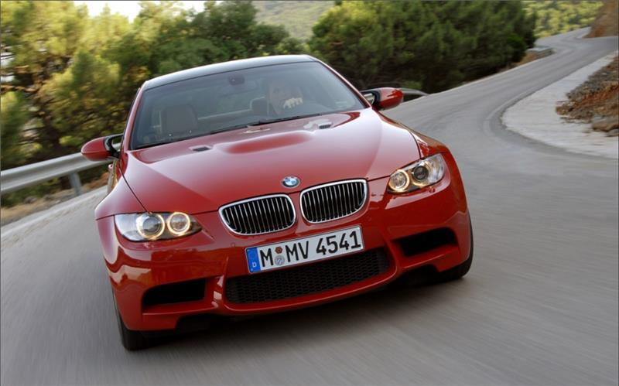
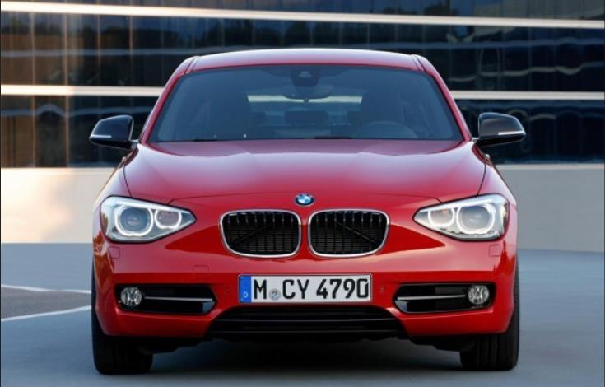
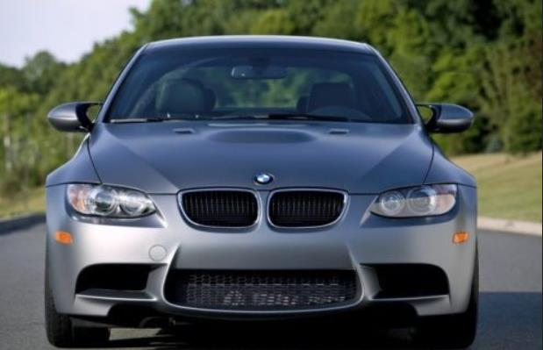














Query – Recommendation results on CARS-196 Dataset:
Query -1
Top – 5 Recommentation results

Slide 28


















Query – Recommendation results on CUB-200 Dataset:
Query
Top – 5 Recommendation results
Fulmar
Fulmar
Albatross
Fulmar
Albatross
Fulmar

